Slide 1
Year 6 Residential at Thorpe Woodland
Monday 19th to Wednesday 21st October

Slide 2
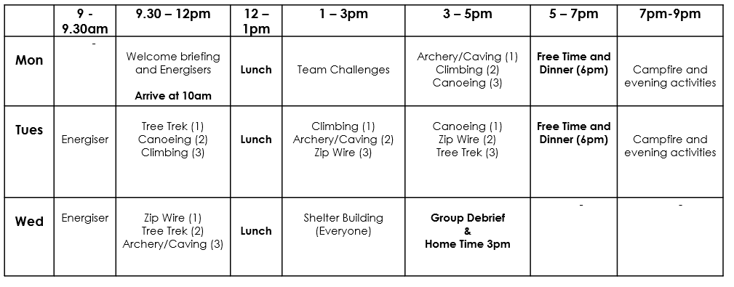

Slide 3
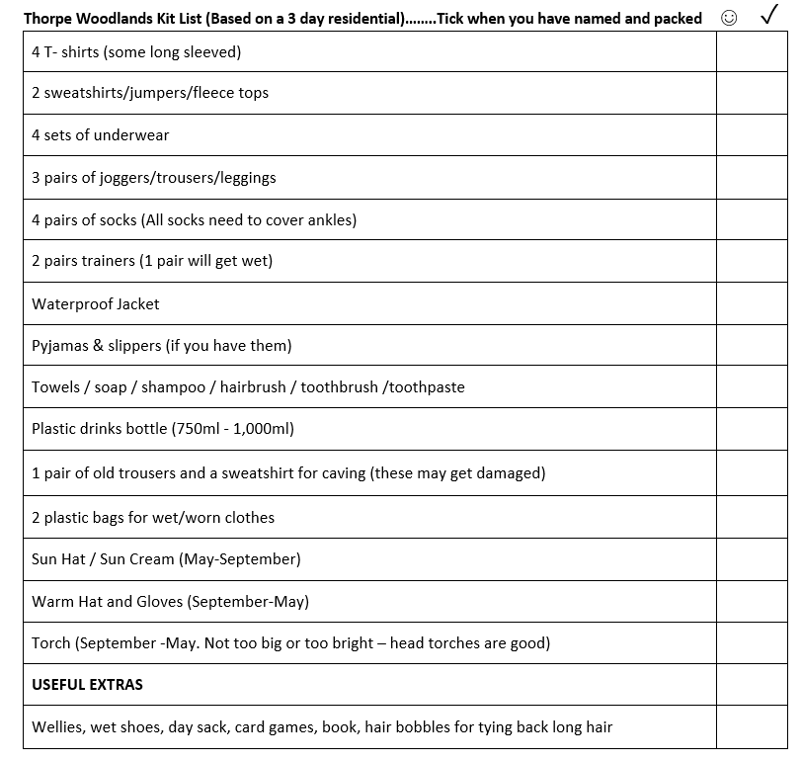

Slide 4
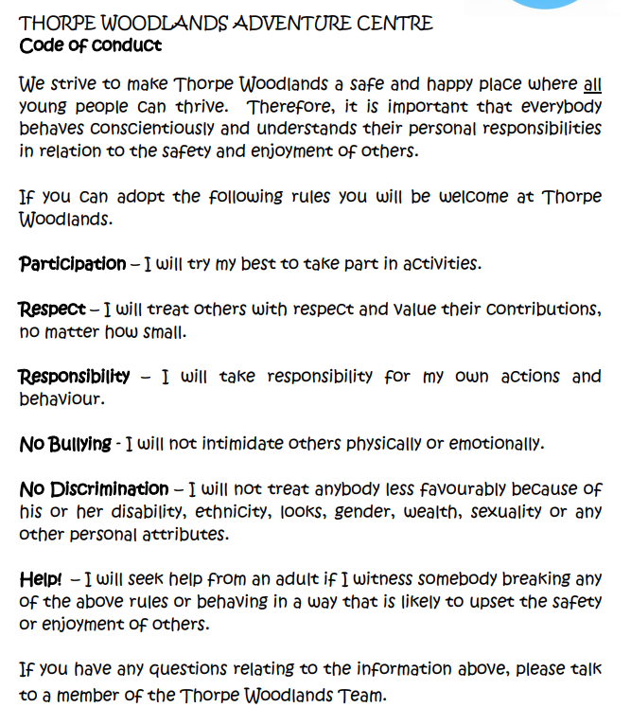

Slide 6
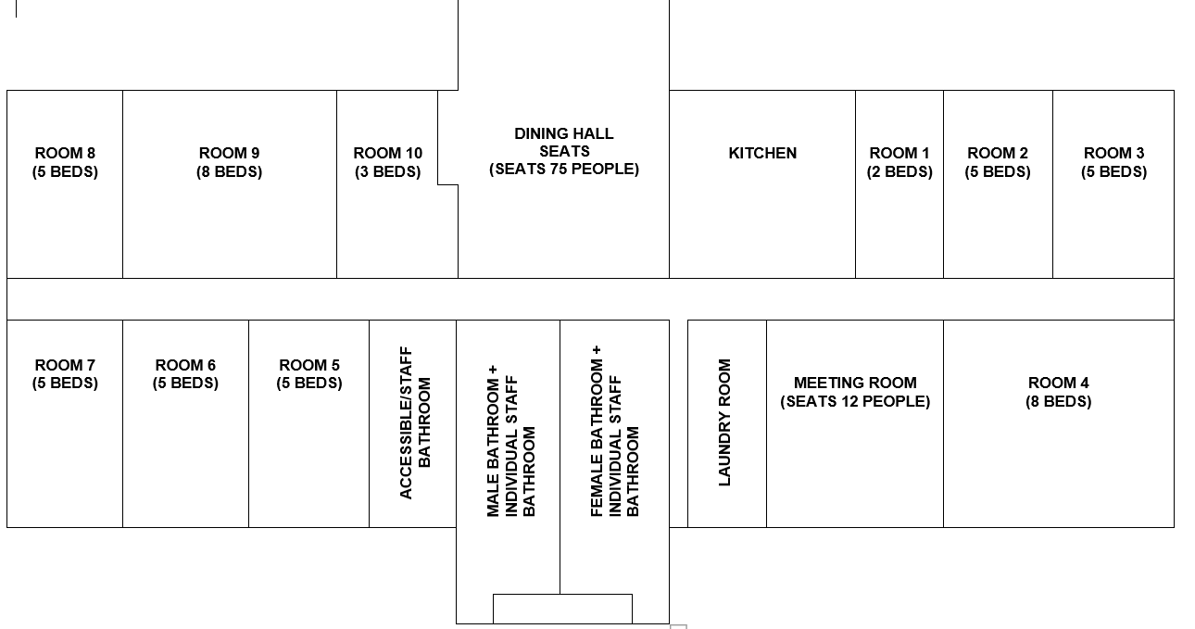

Slide 7


